Slide 1

Big Data Medicare Fraud Detection
By
Chandra Teja Peddi
Jaya Vamsidhar Reddy
Anish Chintamaneni

Slide 2
Introduction
This Project aims to detect and prevent fraudulent actions in the Medicare system by utilizing advanced data processing and analytical tools.
The purpose of our project is to improve the efficiency and effectiveness of the Medicare system by detecting fraudulent actions, which can save millions of dollars in lost payments.

Slide 3
Overview
Our project focuses on detecting and preventing fraudulent actions within the Medicare system through the use of advanced data processing and analytical tools.
The goal of our project is to improve the effectiveness and effectiveness of the Medicare system by finding trends and abnormalities in data.
This may be indicating the existence of fraudulent activity, detecting fraudulent claims, and, eventually, reducing the occurrence of healthcare fraud.

Slide 4
Objectives
Building and deploying powerful analytical models and algorithms to detect and prevent fraud in the Medicare system.
1
Using machine learning and artificial intelligence techniques to improve the accuracy and efficiency of fraud detection procedures.
2
Collaborating with healthcare stakeholders, including Medicare providers and patients, to discover system vulnerabilities and improve fraud prevention methods.
3
Providing policy-makers as well as company stakeholders with practical insights and recommendations to improve the overall productivity and effectiveness of the Medicare system.
4

Slide 5


Why Big Data is Important?
Every day, the healthcare sector generates huge amounts of data, such as electronic health records, medical claims, and patient data.
Big data is important to our endeavor because it enables us to process and analyze massive amounts of data supplied by the Medicare system.
We can use big data analytics to detect trends and abnormalities in data that may indicate fraudulent activity.

Slide 6
Challenges faced from Big Data
One of the most difficult challenges is managing and storing massive amounts of data. Powerful data management technologies are required to ensure that data is easily accessed and processed fast.
Healthcare data is often very unstructured and this complexity makes it difficult to efficiently handle and evaluate the data.
Finally, our project is confronted with data quality issues. The accuracy and completeness of the data are crucial to the success of our project, and we must verify that the data we use is reliable and free of errors or inconsistencies.

Slide 7
Insights
Healthcare providers and facilities are more likely than others to submit fraudulent claims. By identifying these providers and facilities, we can better target our fraud detection efforts and resources.
Certain medical treatments and services are more likely to result in false claims. This data can be utilized to detect suspected fraud more quickly and precisely.
Finding patterns and anomalies in data can be indicating of fraudulent activity. We can construct advanced analytical models and algorithms to detect and prevent fraud more efficiently by recognizing these trends and anomalies.

Slide 8

Implications of Project results
Our project's findings can also be extended to other areas of the healthcare industry and beyond.
By identifying and removing fraudulent providers, we can ensure that legitimate healthcare professionals give high-quality care to consumers.
Our analytical models and algorithms, for example, can be used to detect patterns of fraudulent behavior in other healthcare programs, such as Medicaid or private insurance.
Furthermore, the approaches and procedures we created are applicable to other companies which rely on large data evaluation, such as banking, e-commerce, etc.

Slide 9


Methodologies & Approach
The methodology involved the use of analytics and machine learning algorithms.
Our approach involved several steps, including
data collection,
data preprocessing,
feature engineering,
model training,
model evaluation.

Slide 10




Data -> Collection

Slide 11
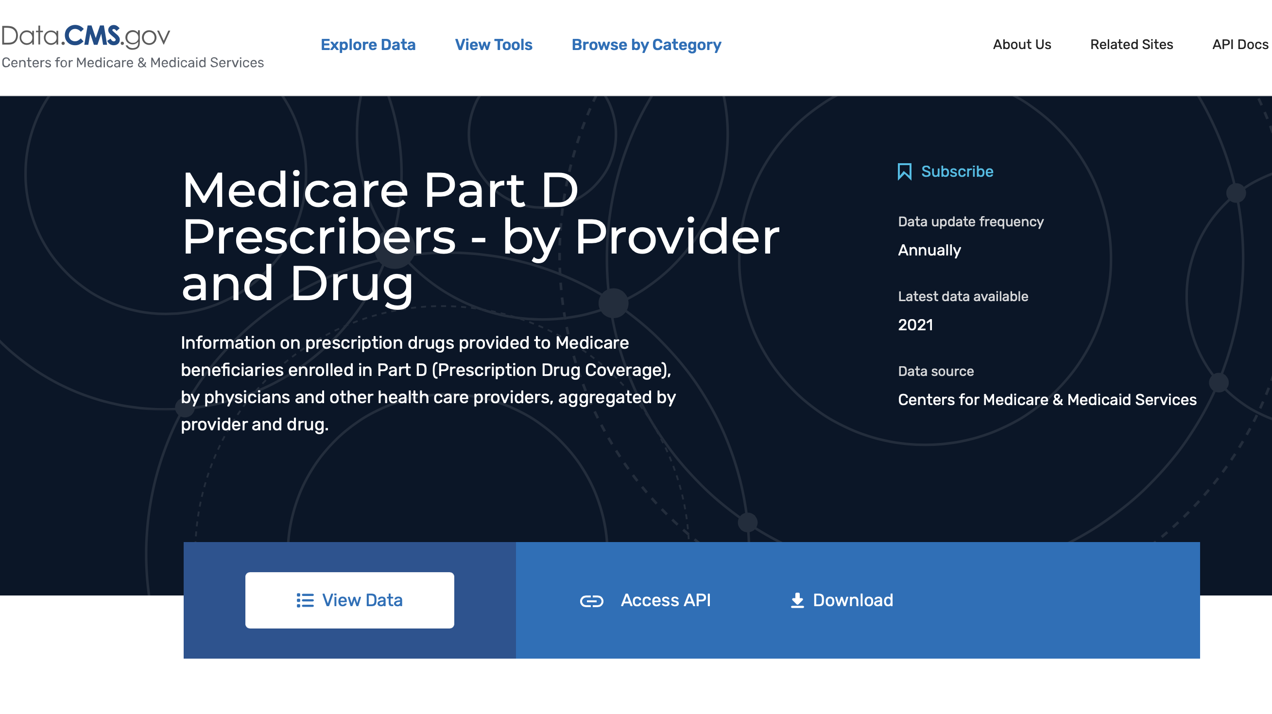
https://data.cms.gov/provider-summary-by-type-of-service/medicare-part-d-prescribers/medicare-part-d-prescribers-by-provider-and-drug

Slide 12
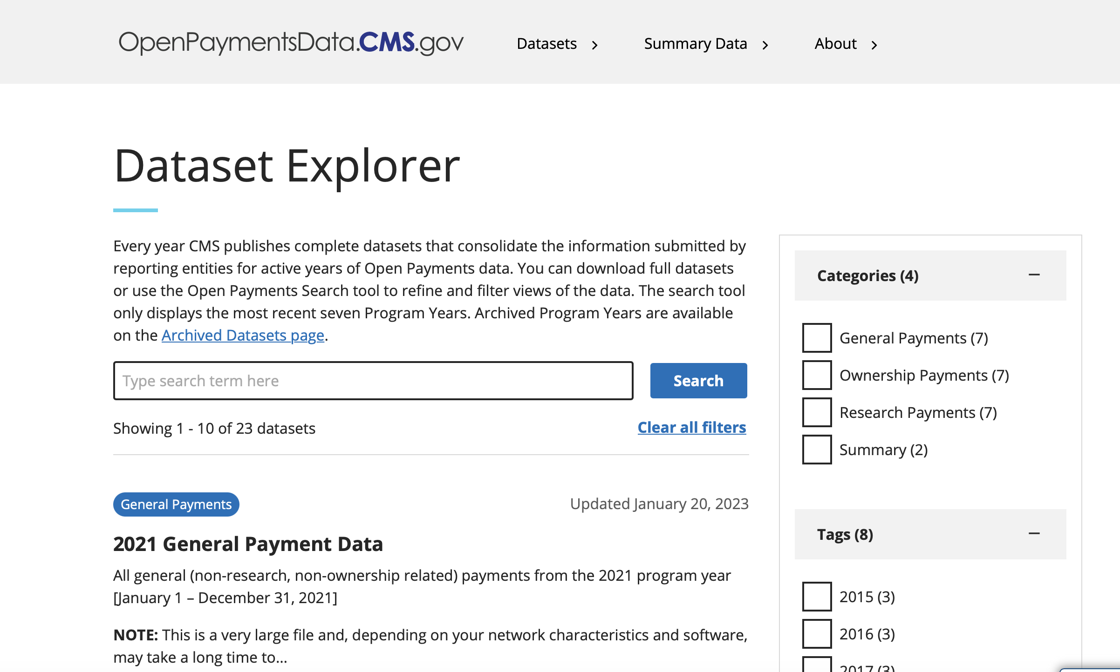
https://openpaymentsdata.cms.gov/datasets

Slide 13
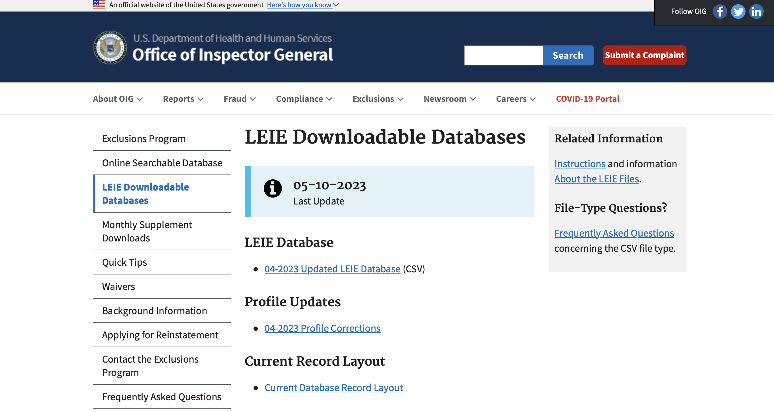
https://oig.hhs.gov/exclusions/exclusions_list.asp

Slide 14
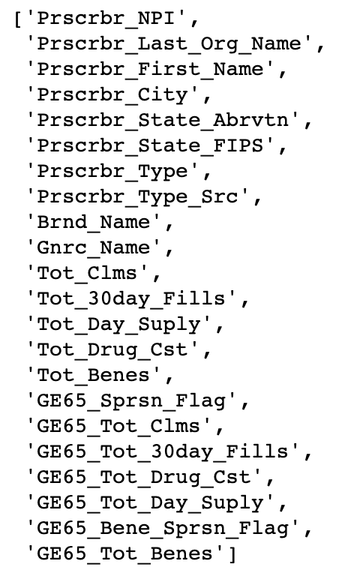
Schema of the Medicare dataset

Slide 15

Data Preprocessing

Slide 16
First, necessary libraries are imported.
All 3 data sets are large and had to be loaded as a PySpark data frame.
Specific features were selected, and the new data frames are cleaned up by removing any null values and duplicates.
New features are created from existing ones by grouping by NPI (National Provider Identifier) and aggregating drug cost, total claims, and total day supply.
New features such as the sum, mean, and max of total drug cost, total claims, and total day supply are calculated.

Slide 17
Payment data is read into a DataFrame. The required columns are selected.
The LEIE DataFrame is created by selecting the 'NPI' and 'EXCLTYPE' columns and filters out any rows with an 'NPI' value of 0.
Next a new column 'is_fraud’ is added to the above DataFrame with a value of 1 for each row. The payment DataFrame is joined with the NPI fraud DataFrame, and any null values in the resulting DataFrame are filled with 0.
Finally, certain irrelevant columns are dropped.

Slide 18
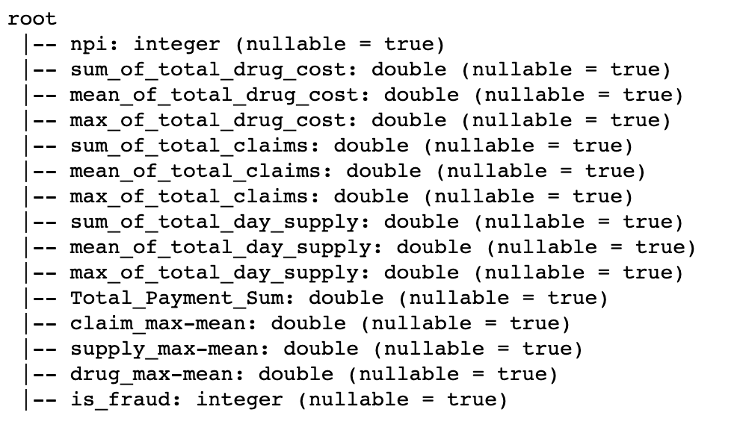
Final Schema

Slide 19
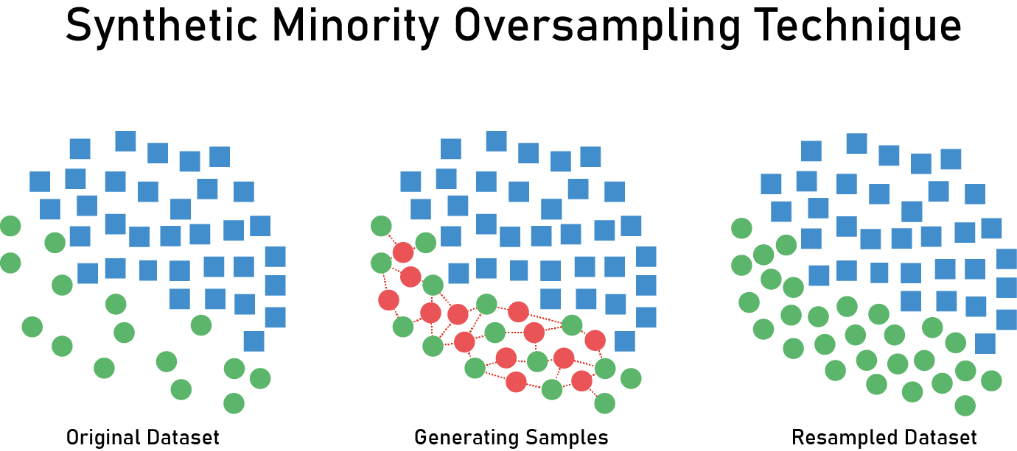
S.M.O.T.E
SMOTE (Synthetic Minority Over-sampling Technique) is a technique used to address the problem of class imbalance in classification tasks.
It generates synthetic data points for the minority class by interpolating between existing minority class samples, creating a balanced distribution of classes in the training dataset.
This helps improve the performance of the classification model by reducing the bias towards the majority class.

Slide 20

Exploratory Data Analysis (E D A)

Slide 21
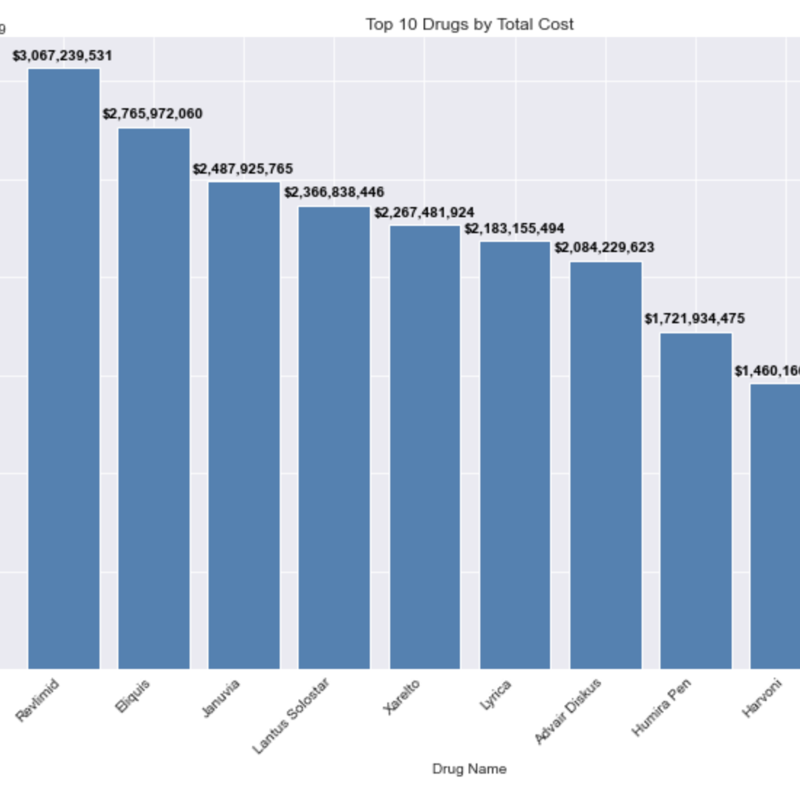
Top 10 drugs by cost

Slide 22
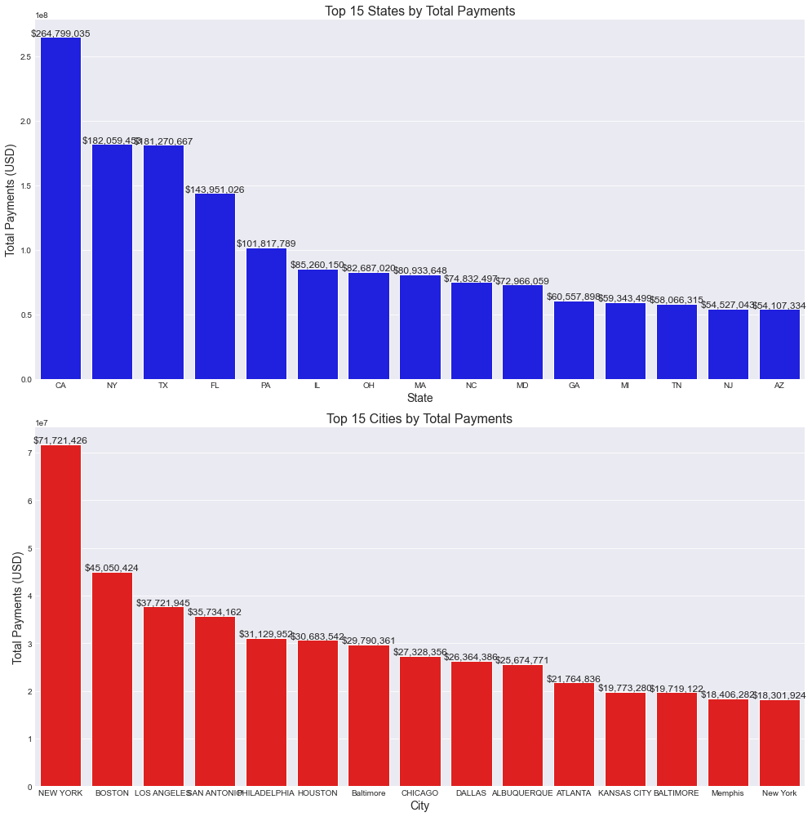
Top 15 states and cities by payments

Slide 23
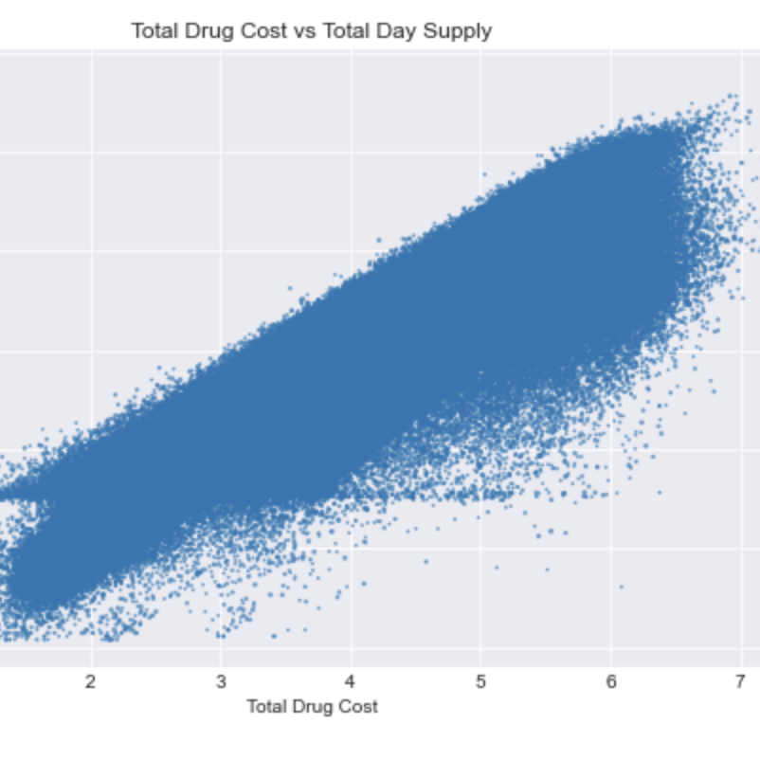
Total drug cost vs total supply

Slide 24
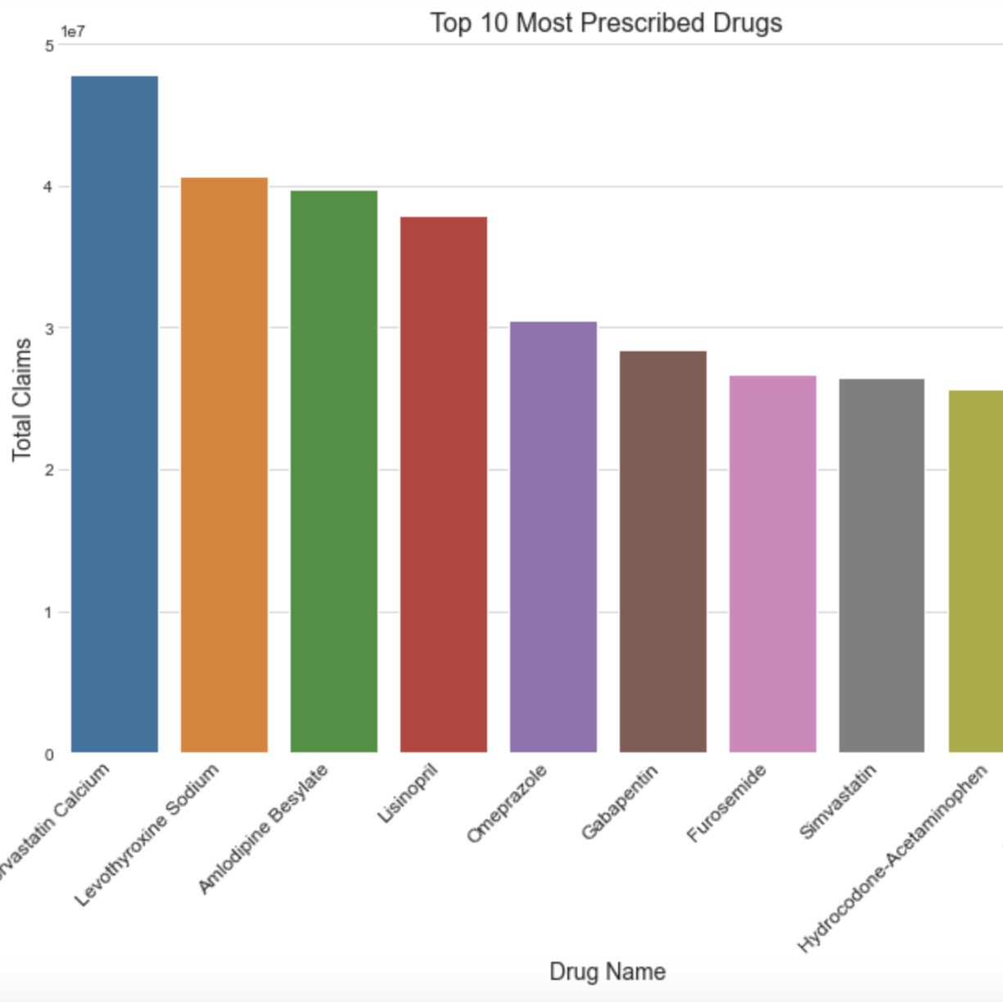
Prescribed drugs by total claims

Slide 25
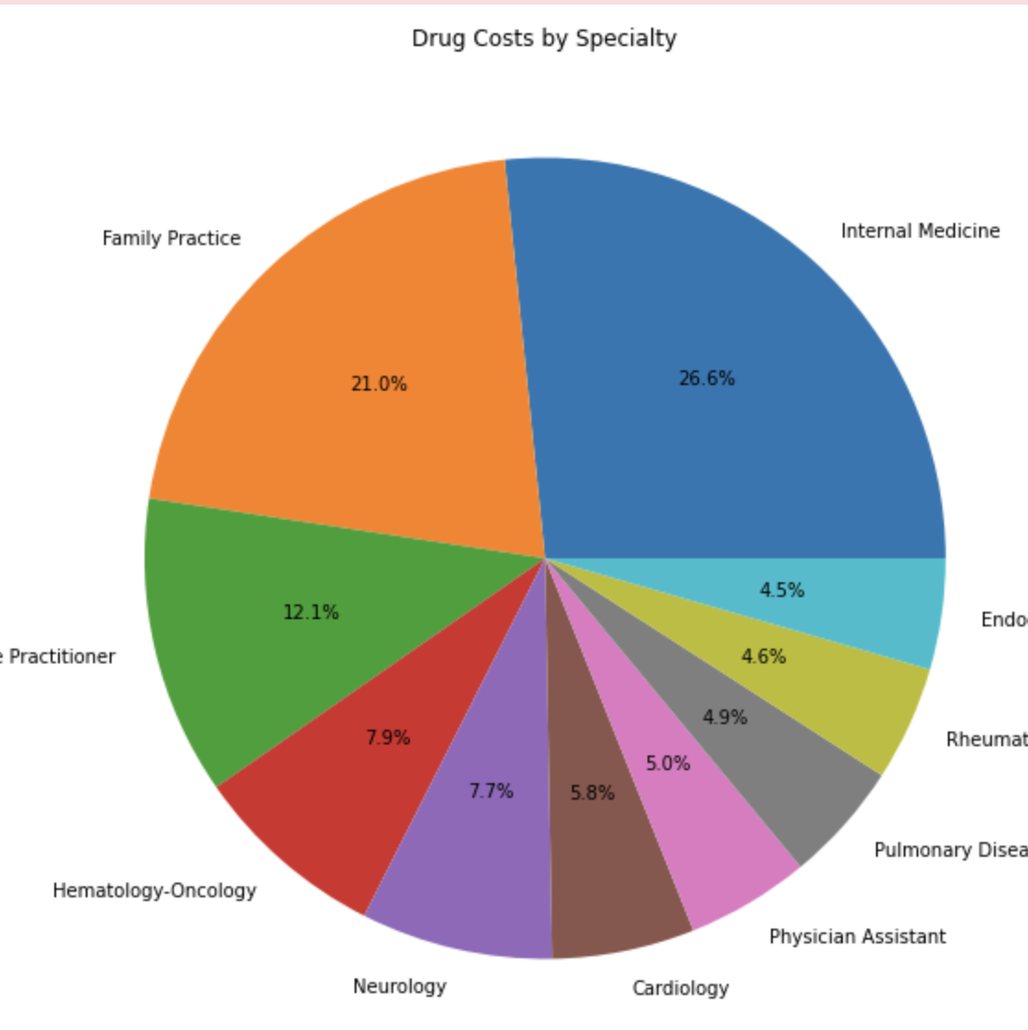
Drug cost by speciality

Slide 26
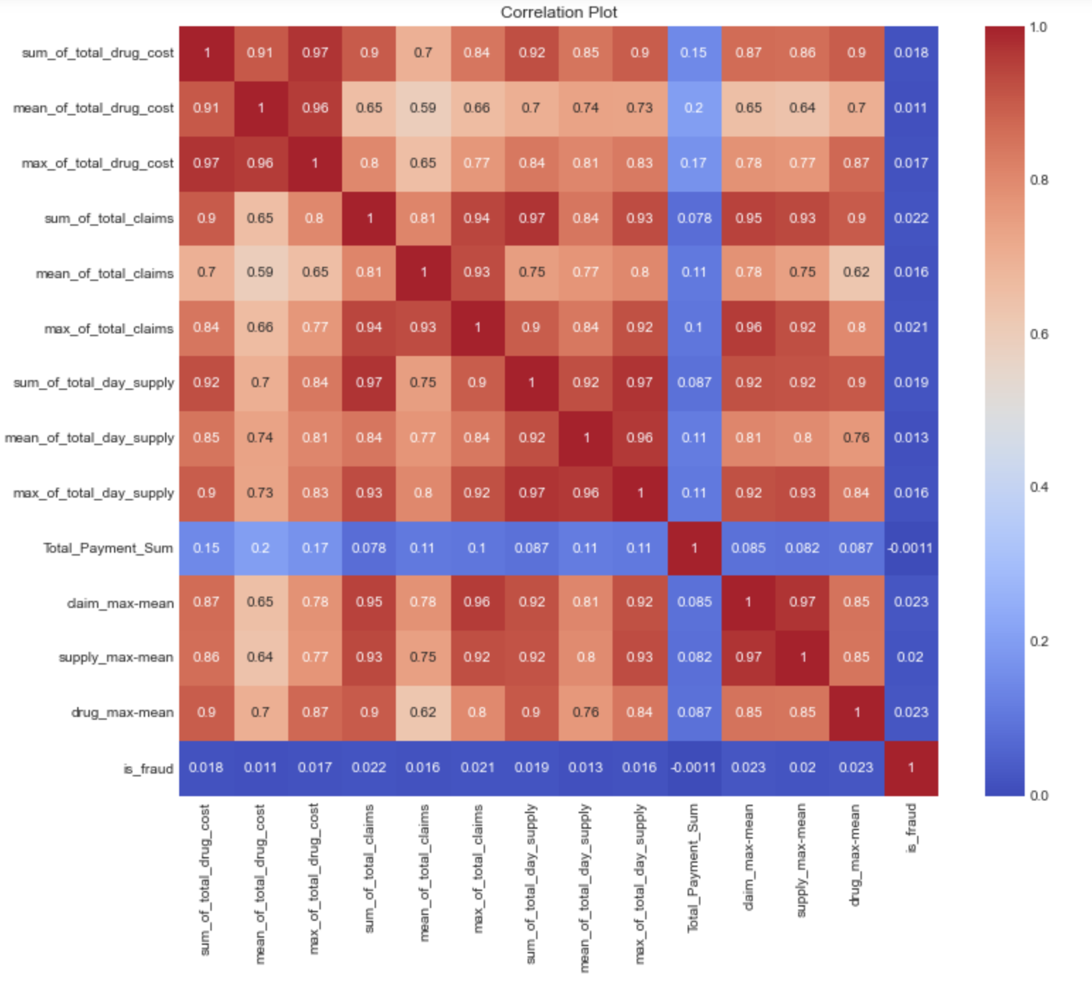
Correlation heatmap

Slide 27

ML Algorithms
We evaluated the performance of several machine learning classifiers, including
Naive Bayes,
Decision Tree,
RandomForest,
LinearSVC,
to determine which algorithm is most effective in detecting potentially fraudulent activity.

Slide 28
Naive Bayes
Naive Bayes is a classification algorithm based on Bayes' theorem.
It assumes independence between features and calculates the probability of a data point belonging to a class based on the probability of each feature in that class.
It has been applied in text classification, spam filtering, and sentiment analysis.

Slide 29
Random Forest
Random forest is an ensemble learning algorithm that creates multiple decision trees and combines their results to improve the accuracy of predictions.
It randomly selects subsets of data and features to train each tree, reducing overfitting.
RF is simple and easy to comprehend, and it performed effectively on our enormous dataset

Slide 30
Decision Tree
A decision tree is a type of machine-learning algorithm used for both classification and regression tasks.
It works by recursively splitting the data into subsets based on the most significant feature, until a stopping criterion is met.
The end result is a tree-like structure where each internal node represents a decision rule based on a feature, and each leaf node represents a class label or a regression value.

Slide 31
Linear SVC
Linear Support Vector Classification (Linear SVC) is a classification algorithm that separates the classes of data using a linear hyperplane.
It finds the best hyperplane that separates the classes by maximizing the margin between the closest data points of different classes.
It is commonly used for binary classification tasks and has been shown to perform well on high-dimensional datasets.

Slide 32

WHY

Slide 33
Naive Bayes is a probabilistic algorithm that works well with high-dimensional data, making it suitable for processing large amounts of Medicare claims data. It also has a low computational cost and can be trained quickly, which is important for handling big data.
Random Forest is robust to noisy data and can handle large data sets with many features, making it suitable for processing Medicare claims data.
LinearSVC is a linear classification algorithm that can handle large data sets with high-dimensional features. It is also efficient in terms of memory and computational resources.
Decision Tree can capture non-linear relationships between features and can handle missing values, making it a versatile algorithm for data exploration and feature engineering.

Slide 34

Model Evaluation

Slide 35
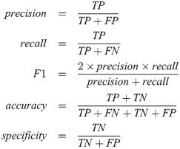
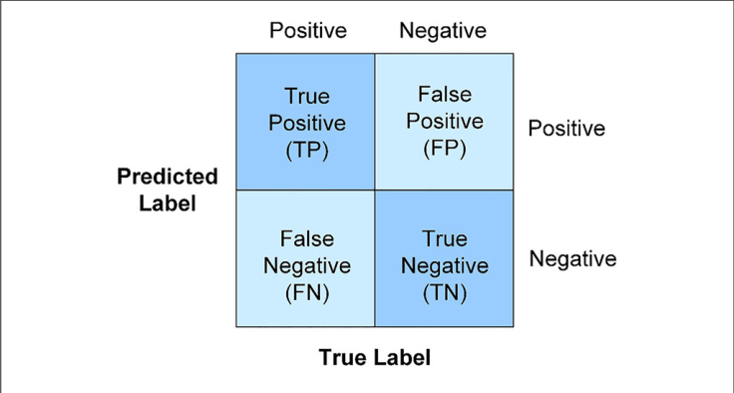
The evaluation of the model performance was done using various metrics, such as Accuracy, precision, recall, and F1 score, and a confusion matrix

Slide 36

Results

Slide 37
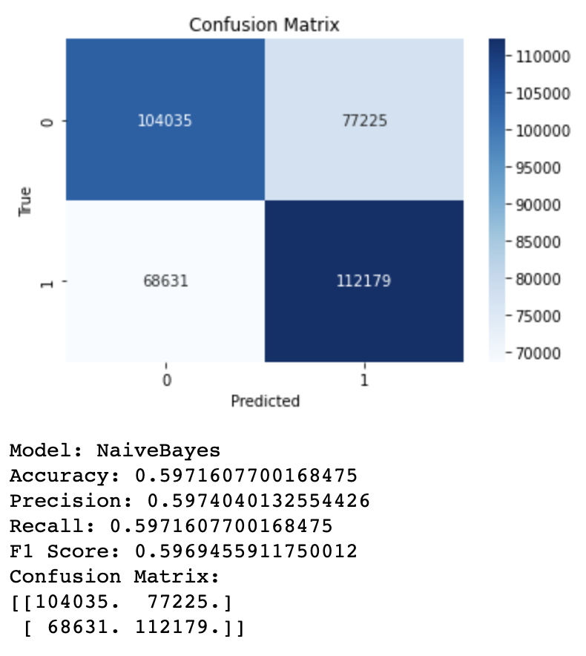
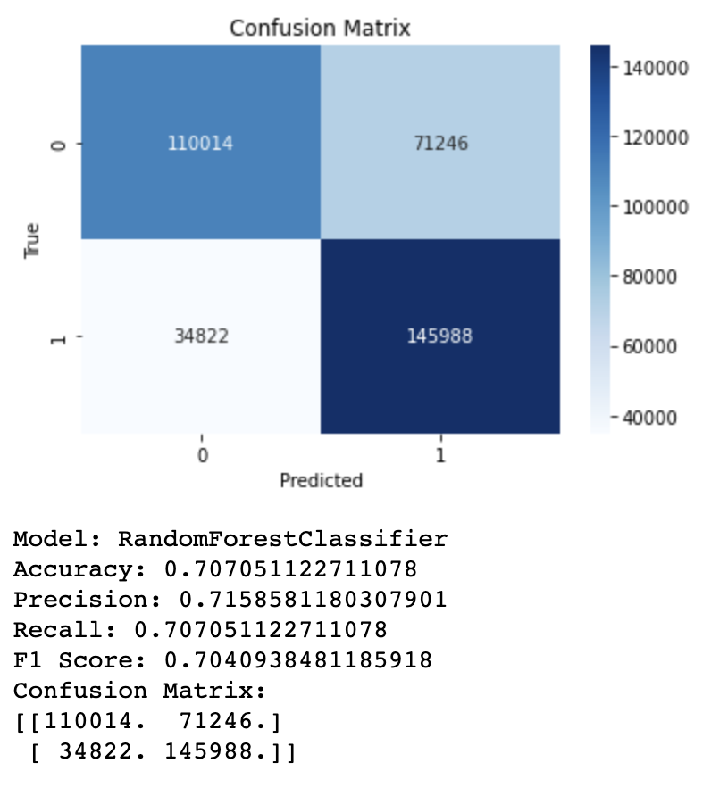

Slide 38
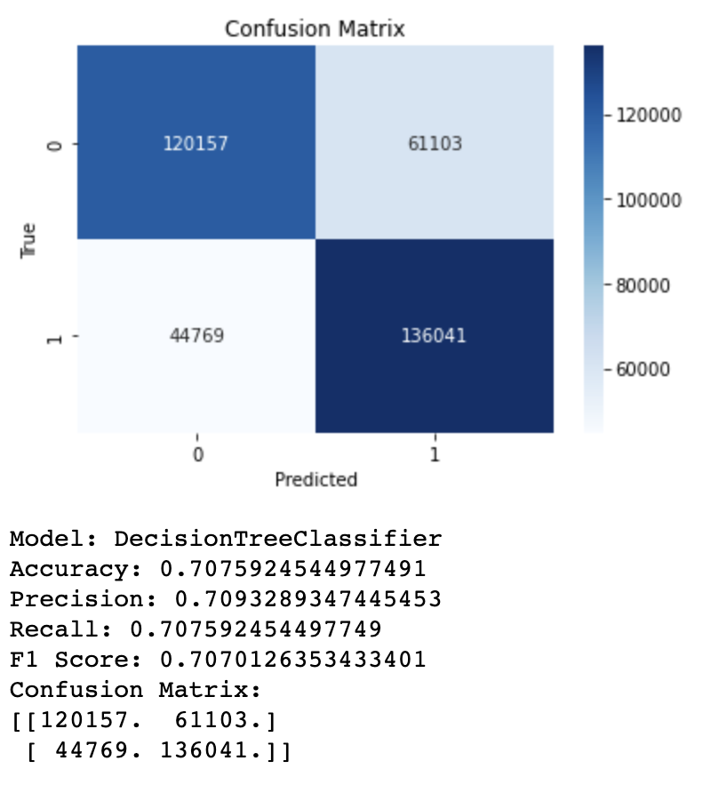
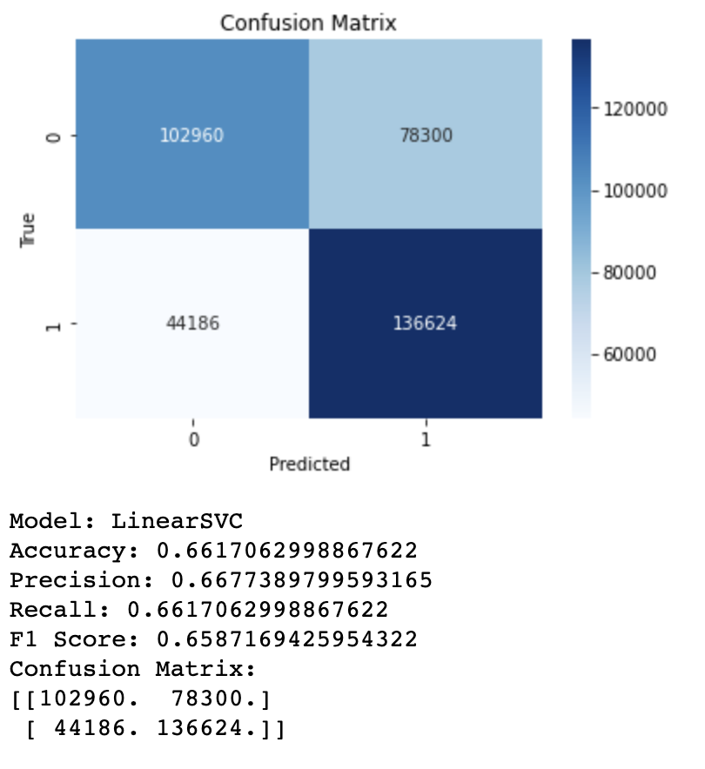

Slide 39
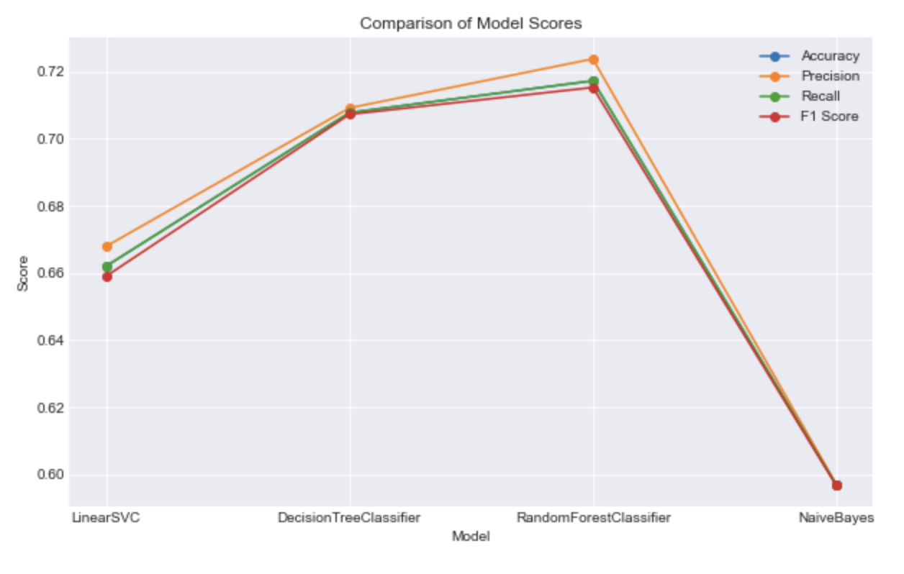

Slide 40
Limitations
One limitation is related to the availability and quality of data used in the project. Medicare claims data is a valuable source of information for detecting fraudulent activities, but it has some limitations.
For example, it does not include data on services provided outside the Medicare program, such as private insurance or Medicaid. Furthermore, claims data can be incomplete, inaccurate, or subject to errors, which can affect the accuracy of the fraud detection algorithms.
Another limitation is related to the generalizability of the findings. The project was based on a specific sample of Medicare claims data, and the results may not be generalizable to other populations or time periods. Moreover, the project was based on a retrospective analysis of claims data.

Slide 41
Summary
To summarize, our project demonstrates the potential of machine learning algorithms to detect potentially fraudulent activity in the Medicare Part D program. While there are limitations to our methodology, our results suggest that these models can be useful tools in identifying instances of fraud and can benefit both patients and the healthcare industry.

Slide 42

Future Scope
First, the project could be extended to analyze data from other healthcare programs, such as Medicaid or private insurance, to detect fraudulent activities that may involve multiple programs.
This could provide a more comprehensive view of healthcare fraud and help identify new patterns of fraudulent activities.
The project could be extended to incorporate additional data sources, such as social media or patient-generated data, which could provide new insights into the behavior and motivations of fraudsters.
The project could be expanded to include real-time fraud detection and prevention, which could help prevent fraudulent activities before they occur.

